Slide 1
Digital Forensics Anti-Forensics and Report
Dr. Tran The Son
Vietnam – Korea University

Slide 2
Content
Anti-forensics
Digital Steganography
Text Steganography
Image Steganography
Audio-video Steganography
Network Steganography
Metadata manipulation
Encryption techniques
Anonymity techniques
Report writing

Slide 3
Anti-Forensics
Anti-forensics has developed into a broad field with methods that address many different computer security issues.
Data hiding techniques (a.k.a Digital Steganography),
data destruction techniques (a.k.a anti-recovery),
data encryption,
cryptographic anonymity,
direct attacks

Slide 4
Digital Steganography
Injunction
bury a hidden message in a trivial, unreadable section of the obvious file.
e.g: message included after the file’s end marker (EOF)
Substitution
swap out pointless portions of the covert file with those in the covert message.
the overt file size will not increase => more secure
Generation
creating a new file that includes the concealed message

Slide 5
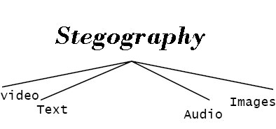

Slide 6
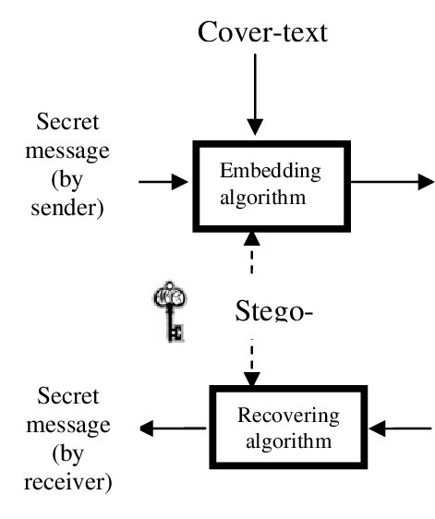
Text Steganography
Text Steganography uses words to conceal sensitive information

Slide 7
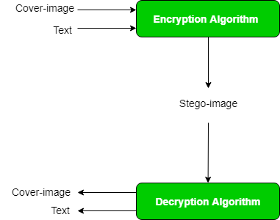
Image Steganography

Slide 8
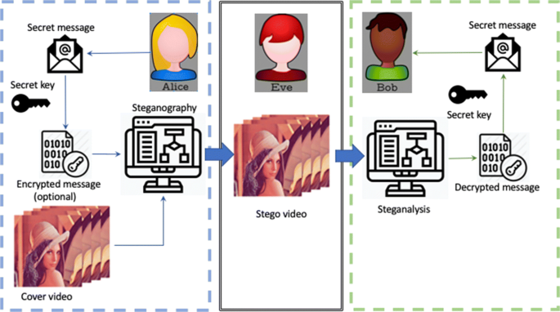
Audio-video Steganography

Slide 9
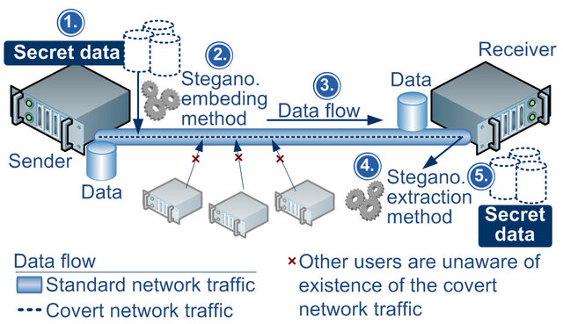
Network Steganography

Slide 10
Metadata manipulation
metadata timestamps in digital files are crucial because they allow investigators to focus their search on a period of time that is relevant to the case at hand
File created: The hard drive’s “created” time can be found here.
Last time the file was accessed: This is the date and time. The access
time will change when a user opens or moves a file from one place to
another. Antivirus software can alter the access times of files while it
scans them.
File modified: This refers to when a file’s data was altered.
MTF last written: When right-clicking a file and choosing Properties

Slide 11
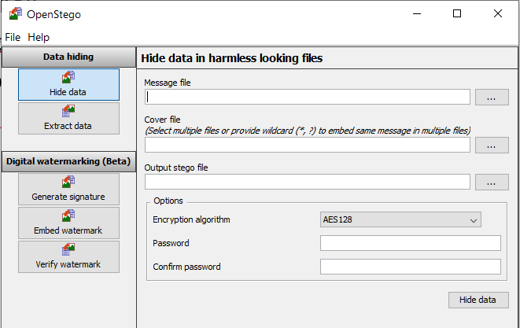
Practice 1
Linux/Kali
Steghide
Windows
OpenStego
Dấu thông tin “họ và tên” vào trong 1 file ảnh nào đấy
Gửi đến email của thầy

Slide 12
Practice 2
Refer to link
Tìm ra đoạn code mã hóa và giải mã khi thực hiện dấu tin trong ảnh (hoặc trong text/audio/video)
https://github.com/Priyansh-15/Steganography-Tools/

Slide 13
Encryption techniques
Disk encryption using open-source tools
VeraCrypt: https://www.veracrypt.fr/en/Home.html
CipherShed: http://www.ciphershed.org/

Slide 14
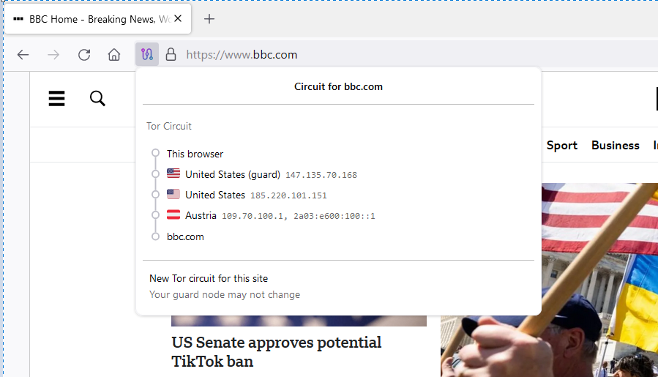
Anonymity techniques
TOR Browser www.torproject.org
I2P: https://geti2p.net/
Freenet: https://www.hyphanet.org/

Slide 15
Digital forensic reports
Investigator Information
examiner(s) who handled the case and what his/her role was in the investigation
Case description
Investigation (Analysis)
Summary of findings
Explanation of terms
Example
https://www.collegesidekick.com/study-docs/4170337

